Slide 1



Pharmacy POS System
Modernizing Pharmaceutical Operations in Zambia
CSC 4630 - Advanced Software Engineering Group 20 | Engineering a Safer Health Ecosystem

Slide 2
PRESENTATION AGENDA
Problem Statement & Context
System Constraints (NFRs)
Business Case & Feasibility
Project Scope
Risk Assessment
Story-Mode Use Cases
Functional Requirements
Iteration Planning
CSC 4630 | Group 20

Slide 3
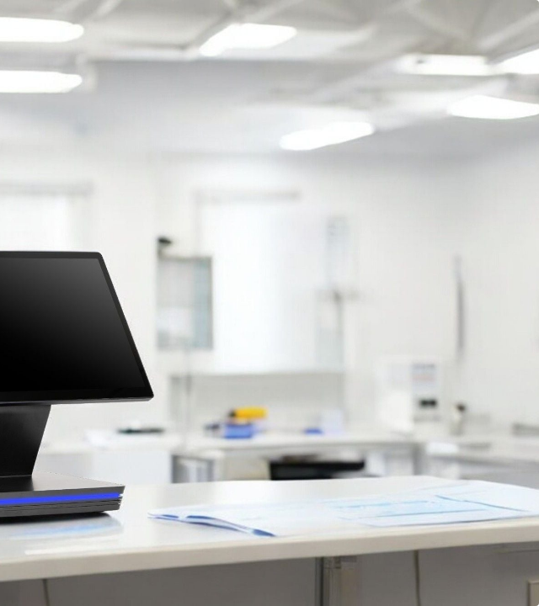
THE CHALLENGE
Many Zambian pharmacies struggle with legacy manual record-keeping, leading to critical operational failures:
Inadvertent Sale of expired medication.
Stock Shortages of life-saving drugs.
Pricing Inaccuracies and poor tracking.
Compliance Risks with local regulations.

Slide 4



THE BUSINESS CASE
Operational Value
Strategic Value
Immediate improvement in sales accuracy and real-time inventory synchronization. Reduced human error translates directly to higher customer trust and safety.
Automated expiry monitoring prevents stock loss. Compliance with Zambian pharmaceutical laws becomes built-in rather than a manual chore.
Financial Impact
Scalability
Setup costs are offset by reduced inventory wastage and faster transaction times, allowing more customers to be served per hour.
Modular architecture allows the system to grow as the pharmacy expands from a single location to a regional chain.

Slide 5
FEASIBILITY ASSESSMENT
Feasibility Type | Description & Conclusion
Technical | Leveraging Java/Python and MySQL/PostgreSQL. Local hardware infrastructure (scanners/printers) is readily available in Zambia.
Economic | Investment is justified by substantial reduction in losses from expired stock and increased operational efficiency.
Operational | Intuitive UX design ensures that pharmacists and cashiers require minimal training to transition from manual systems.
Schedule | Agile methodology allows for rapid prototyping and incremental releases within the academic timeline.

Slide 6









PROJECT RISK MANAGEMENT
Security Risk
Data Loss
User Resistance
Unauthorized access to financial/patient data. Mitigation: Role-based access (RBAC).
Loss of prescription data due to system failure. Mitigation: Automated backups.
Staff hesitation toward automation. Mitigation: Hands-on training sessions.
Regulatory
Technical
Failure to meet Zambian pharmacy laws. Mitigation: Continuous legal reviews.
Slowdowns during peak hours. Mitigation: Performance load testing.

Slide 7
FUNCTIONAL REQUIREMENTS
Process medicine sales and generate receipts.
Batch number and expiry date tracking.
Validate and record prescription-based sales.
Automatic block on expired medicine sales.
Multi-mode payment: Cash, Card, Mobile Money.
Low-stock and expiry dashboard alerts.
Auto-update inventory levels per transaction.
Daily, weekly, and monthly financial reports.

Slide 8







CORE NON-FUNCTIONAL REQUIREMENTS
Performance
Usability
Security
Reliability
Sales processing in under 3 seconds to handle busy Zambian market hours.
Clean, clutter-free interface optimized for rapid input and readability.
Encrypted data storage and strictly enforced permissions for Admins vs. Cashiers.
High availability with persistent data integrity for stock levels.

Slide 9

PROJECT SCOPE
In Scope
Real-time inventory & alerts
Mobile Money integration
Sales & Stock reporting
Out of Scope
Online eCommerce sales
NHIMA insurance claims

Slide 10


SYSTEM USE CASES: Atleast 10%
Use Case 01- Process Prescription Sale
Use Case 02- Process Over-the-Counter(OTC) Sale
The Cashier enters the patients details and prescription ID.The system validates the prescription digitally,checks insurance eligibility and co-pay,and process the payment. It logs the sale against the specific pharmacist who verified the order
The Cashier Scans OTC items,calculates total,processes payment,and prints receipt.

Slide 11
SYSTEM USE CASES: Atleast 10%
Use Case 03-Manage Inventory
Use Case 04-Handle Refill Request
The pharmacist/Manager adds new stock,updates quantities,and handles expired or recalled medications.
The system automatically flags prescription due for refill,or the patient requests one,which the pharmacists approves.

Slide 12
ELABORATION PHASE: WEEKS 5–7
Detailed Use Cases
Implementation
30% Completion: Process Sale, Add Medicine, Reports.
Partial implementation of 'Process Sale' logic.
Core Architecture
Domain Modeling
Defining the layered structure and proof-of-concept.
Mapping Medicine, Prescription, and Sales relationships.

Slide 13


Questions?
Thank you for your attention!
CSC 4630 | Group 20 | Advanced Software Engineering

